Slide 1

Capstone Project
Yaroslav Kechkin
May 2nd, 2012

Slide 2
Overview
Capstone.exe is the program for encryption and decryption of text files. It uses 128 ASCII and 128 extended ASCII characters for generation of the key and further encryption of the text. Developing of this program took me several weeks because it was my first program and I was not familiar with C++ language on necessary level. Overall the project took me two months, which incudes documentation, preparation, writing code and testing.

Slide 3
About
The program is utilizing the polyalphabetic substitution cipher – Vigenere. I used extended Vigenere alphabet. Regular Vigenere is based on 26 alphabetic characters, my program utilizes 256 ASCII characters thus corresponding to the equation
Ci=(Pi+Ki)mod 256 compared to Ci=(Pi+Ki)mod 26
For key generation I used pseudorandom number generator based on a seed derived from system time – not the best technique but it also based on ASCII characters which helps to increase the strength of the key.
Using 256 characters to encrypt instead of 26 increases the strength of the program. The study done by professor Kallam and Dr. Kumar shows that using 256 ASCII characters in encryption algorithm is safe and it would take 2,530,000,000,000,000,000,000 years to brute force it using 1 decryption pre microsecond (Kallam, Kumar, Vinaya, & Kumar, 2011).

Slide 4
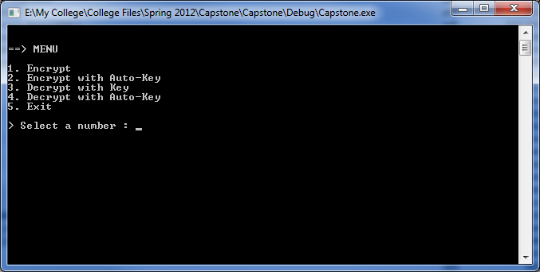
Interface

Slide 5
Presentation
Includes:
Capstone.exe
Test.txt containing the large amount of text to test encryption and decryption modules

Slide 6
Problems
Biggest problems I encountered during the development of the program were:
Reading in text file in a string and saving a string into a text file
Extending the key to match the length of the text
Dividing the code into three files to make code easy to read
Using strings as they were arrays (substitution made the program use less resources)

Slide 7
Legal
This software is released under the terms of GNU GPL version 3 license.
This license provides four freedoms for users:
the freedom to use the software for any purpose,
the freedom to change the software to suit your needs,
the freedom to share the software with your friends and neighbors, and
the freedom to share the changes you make.
For a copy of the GNU General Public License go to http://www.gnu.org/licenses/

Slide 8
Future versions
Future versions of this program will include:
Graphical User Interface
Different algorithm to generate the random key
Encryption of the key
Experimentation with one-time pad encryption – “the only cryptosystem that exhibits what is referred to as perfect secrecy” (Stallings, 2011).
Secure transfer of keys between parties (PKI encryption)

Slide 9
References
Kallam, R. B., Kumar, S. U., Vinaya, A., & Kumar, V. S. (2011). A Contemporary Polyalphabetic Cipher using Comprehensive Vigenere Table. World of Computer Science and Information Technology Journal (WCSIT), 1(4), 167-171.
Stallings, W. (2011). Cryptography and Network Security: Principles and Practice, 5th ed. Pearson Education, Inc: Upper Saddle River, NY.

